Slide 1
Ranking
In Boolean queries a document either matches or does not match the query.
_ The order of the returned documents is not specified (often reflects the internal organization of the index.).
_ In large collections, the number of (unordered) returned documents is far too big for“human consumption”
_ Need to rank the matching documents according to the (estimated) relevance of a
document to a query (assigning a score to a (document, query) pair).
_ In actual Digital Libraries, ranking is essential for both: Boolean queries and Fulltext (non-boolean) queries.

Slide 2
Ranking
Full text queries (non boolean)
The query is a sequence of query terms, and it’s not practical to consider them as an AND nor as an OR query.
Need to define a method to compute a similarity measure between the query and the
document. Results will be ranked according to the similarity measures.
We need to represent the document and the query in some mathematical form so to compute their similarity.
The most used format is a vector.

Slide 3
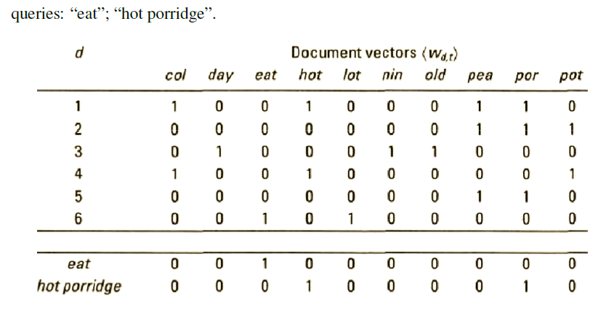
Ranking

Slide 4
Similarity Measure
Given the pair (“hot porridge”,d1) there similarity measure can be obtained as their innerproduct
(“hot porridge”,d1) (0;0;0;1;0;0;0;0;1;0) _ (1;0;0;1;0;0;0;1;1;0) = 2
(“hot porridge”,d2) (0;0;0;1;0;0;0;0;1;0) _ (0;0;0;0;0;0;0;1;1;1) = 3
(“hot porridge”,d3) (0;0;0;1;0;0;0;0;1;0) _ (0;1;0;0;0;1;1;0;0;0) = 5
(“hot porridge”,d4) (0;0;0;1;0;0;0;0;1;0) _ (1;0;0;1;0;0;0;0;0;1) = 3
(“hot porridge”,d5) (0;0;0;1;0;0;0;0;1;0) _ (0;0;0;0;0;0;0;1;1;0) = 2
(“hot porridge”,d6) (0;0;0;1;0;0;0;0;1;0) _ (0;0;1;0;1;0;0;0;0;0) = 4

Slide 5
Exercise :
Find the similarity measure of
(“eat”,d1), (“eat”,d2), (“eat”,d3), (“eat”,d4), (“eat”,d5), (“eat”,d6)

Slide 6
Drawbacks :
No account of term frequency in the document (i.e. how many times a term appears in the document)
_ No account of term scarcity (in how many documents the term appears)
_ Long documents with many terms are favoured

Slide 7
Advantages:
Very efficient.
Predictable, easy to explain.
Structured queries.
Works well when searchers knows exactly what is wanted.

Slide 8
Disadvantages:
Most people find it difficult to create good Boolean queries.
Difficulty increases with size of collection.
Precision and recall usually have strong inverse correlation.
Predictability of results causes people to overestimate recall.

